Slide 1


UNIVERSITY OF ENGINEERING & MANAGEMENT, KOLKATA
Course Name : AI & ML

Slide 2
 | UNIVERSITY OF ENGINEERING & MANAGEMENT, KOLKATA
What is Proposition?
A proposition (or a statement) is classified as a declarative sentence to which only one of the truth values. i.e. true or false.
Example: New Delhi is the capital of India. (T)
The square of 4 is 16. (T)
The cube of 5 is 122. (F)
Bring me coffee. (Not a proposition)

Slide 3
 | UNIVERSITY OF ENGINEERING & MANAGEMENT, KOLKATA
CONNECTIVES (PROPOSITIONAL CONNECTIVES OR LOGICAL CONNECTIVES)
There are five basic connectives:
(i) Negation (NOT)
(ii) Conjunction (AND)
(iii) Disjunction (OR)
(iv) Implication (IF THEN )
(v) If and Only If. (IFF)

Slide 4
 | UNIVERSITY OF ENGINEERING & MANAGEMENT, KOLKATA
P (Proposition) | NOT P
T | F
F | T
Truth Table for NOT
P | Q | P AND Q
F | F | F
F | T | F
T | F | F
T | T | T
Truth Table for AND

Slide 5
 | UNIVERSITY OF ENGINEERING & MANAGEMENT, KOLKATA
P | Q | P OR Q
F | F | F
F | T | T
T | F | T
T | T | T
Truth Table for OR

Slide 6
 | UNIVERSITY OF ENGINEERING & MANAGEMENT, KOLKATA
P | Q | P → Q
F | F | T
F | T | T
T | F | F
T | T | T
Truth Table for IF THEN

Slide 7
 | UNIVERSITY OF ENGINEERING & MANAGEMENT, KOLKATA
P | Q | P < - > Q
F | F | T
F | T | F
T | F | F
T | T | T
Truth Table for IF and only IF

Slide 8
 | UNIVERSITY OF ENGINEERING & MANAGEMENT, KOLKATA
Few Definitions:
When a statement cannot be logically broken into smaller statements, we call it atomic.
Let r be a propositional formula, constructed by connecting atomic propositions p, q, s, etc. by operators. An interpretation for r is a function that maps v (p), v (q) and v (s) into true or false values that together keep r true.

Slide 9
 | UNIVERSITY OF ENGINEERING & MANAGEMENT, KOLKATA
A propositional formula is called satisfiable if its value is true for some interpretation.
A propositional formula is unsatisfiable or contradictory if it is not satisfiable, i.e., for no interpretation it is true.
A propositional formula is called valid or tautology, when it is true for all possible interpretations.

Slide 10
 | UNIVERSITY OF ENGINEERING & MANAGEMENT, KOLKATA
Example
If P represents 'This book is good' and Q represents 'This book is cheap',
write the following sentences in symbolic form:
(a) This book is good and cheap.
(b) This book is not good but cheap.
(c) This book is costly but good.
(d) This book is neither good nor cheap.
(e) This book is either good or cheap.

Slide 11
 | UNIVERSITY OF ENGINEERING & MANAGEMENT, KOLKATA
Translate the following sentences into propositional forms:
(a) If it is not raining and I have the time, then I will go to a movie.
(b) It is raining and I will not go to a movie..
(c) It is not raining.
(d) I will not go to a movie.
(e) I will go to a movie if only if it is not raining.

Slide 12
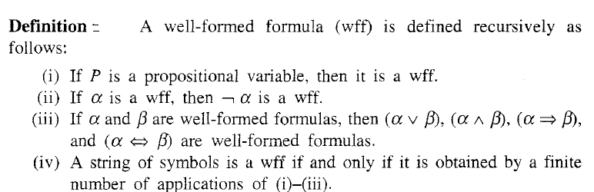
 | UNIVERSITY OF ENGINEERING & MANAGEMENT, KOLKATA
Well Formed Formula

Slide 13
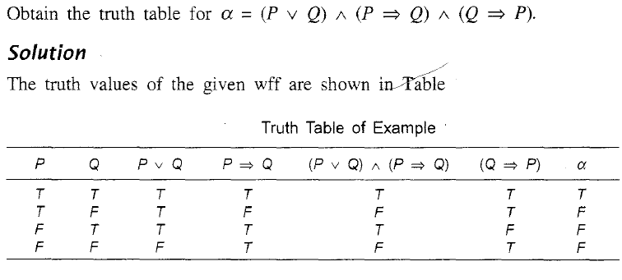
 | UNIVERSITY OF ENGINEERING & MANAGEMENT, KOLKATA
WFF Example

Slide 14
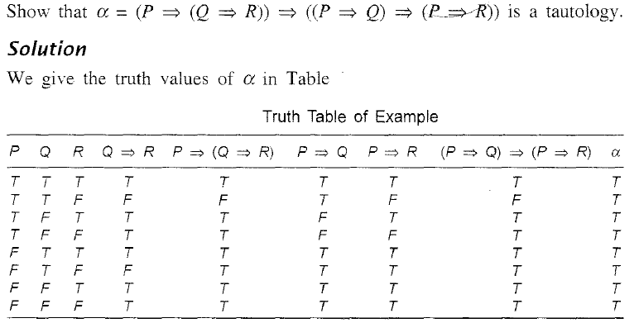
 | UNIVERSITY OF ENGINEERING & MANAGEMENT, KOLKATA

Slide 15
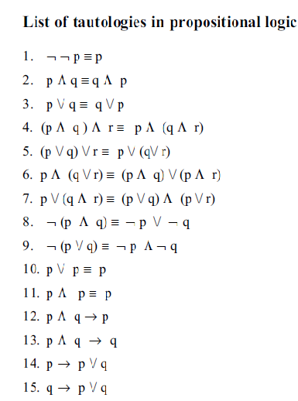
 | UNIVERSITY OF ENGINEERING & MANAGEMENT, KOLKATA

Slide 16
 | UNIVERSITY OF ENGINEERING & MANAGEMENT, KOLKATA
Theorem Proving by Propositional Logic
i) Semantic
ii) Syntactic
Semantic method involves forward chaining and backward chaining method.
Forward chaining: When all the premises are true, check whether the conclusion is true. Under this circumstance, we say that forward chaining holds good.
Backward chaining: When all the consequences are false, check whether at least one of the premises is false.

Slide 17
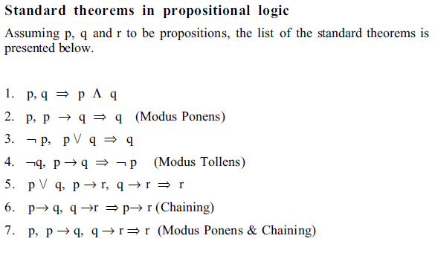
 | UNIVERSITY OF ENGINEERING & MANAGEMENT, KOLKATA

Slide 18
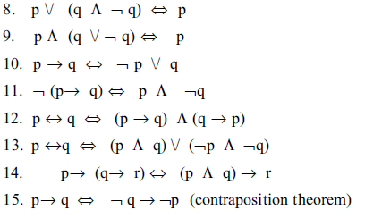
 | UNIVERSITY OF ENGINEERING & MANAGEMENT, KOLKATA

Slide 19
 | UNIVERSITY OF ENGINEERING & MANAGEMENT, KOLKATA
Approach for Syntactic Prove
Method of Substitution
By this method, left-hand side (or right-hand side) of the statement to be proved is chosen and the standard formulas, presented above, are applied selectively to prove the other side of the statement.
Ex : Prove the contraposition theorem.

